Slide 1
COS 212 Data Compression: Adaptive Huffman Coding & Run-Length Encoding

Slide 2
Huffman Coding
Basic idea behind Huffman coding
Construct a binary tree based on symbol probabilities
Determine the encoding for each symbol by tree traversal
How do we know the probabilities?
Calculate average character frequencies in the language being encoded, and use these frequencies as probabilities
Will the same frequencies be optimal for the COS 212 textbook and “Harry Potter and the Philosopher’s Stone”?
The simple solution
Calculate frequencies for the text being encoded, and send the corresponding Huffman codes together with the compressed file
But the text may be long and we now need to run through it twice (once to compute frequencies, and once to compress it)
The table of codes can also be cumbersome to work with
Adaptive Huffman coding
Go through the text once, generate codes as you go
Initially inefficient encoding that improves as we “learn” frequencies
The receiver reconstructs the same Huffman tree dynamically
To decode, the sender and receiver must agree on alphabet order

Slide 3
Adaptive Huffman Coding
Start with a Huffman tree with only one node
This node stores the entire alphabet and is called the alphabet node
The frequency for this node must be 0
We encode text letter-by-letter
There is no pre-processing to find letter frequencies
Move letters out of the alphabet node when they’re first encoded
Two cases for encoding a letter
If the letter is still contained in the alphabet node
If the letter is not contained in the alphabet node
Frequency: 0
(A B C D E F)

Slide 4
Adaptive Huffman Coding
If the letter i is still contained in the alphabet node
Generate a code that identifies the position of i in the alphabet
Start with Huffman code of alphabet node (empty on 1st iteration)
Add a sequence of 1 bits where the number corresponds to the position of the letter in the alphabet
Indicate the end of the code with a single 0 bit
Append the generated code to the encoded bit sequence
Split the letter i out of the alphabet node
In the alphabet node, move the last letter to overwrite the letter i
Create a new node for the letter i, with a frequency of 1
Code for A : 10
Code for D : 11110
Alphabet: (A B C D E F)
Frequency: 1
Create a new parent node
Left child is the alphabet node
Right child is the new node
Cumulative frequency is 1
Increment counts in new node’s ancestors
0
1
Frequency: 0
Frequency: 1
(A B C D E F)
(F B C D E)
A
Input text: AAFCCCBDD
Encoding: 10101000111000111100110
10

Slide 5
Adaptive Huffman Coding
If the letter i is not contained in the alphabet node
The letter is already in the Huffman tree
Build a Huffman code by traversing from the root to the letter’s leaf
Append this code to the encoded bit sequence
Increment the frequency of the letter’s leaf and every ancestor node to more accurately reflect the actual probabilities in the input text
Any frequency increment may break Huffman tree structure
We then need to repair the tree structure
We’ll link the nodes using a linked list in breadth-first, right-to-left order
The sibling property must be maintained
If the frequencies in the list are non-increasing, the tree is a Huffman tree
If the sibling property is broken at any point, it must be restored
Frequency: 1
0
1
1
Frequency: 0
2
Frequency: 1
(F B C D E)
A
Input text: AAFCCCBDD
Frequencies in list: 1 2 0
Encoding: 10101000111000111100110
10
1
Sibling property broken

Slide 6
Adaptive Huffman Coding
If the letter i is not contained in the alphabet node
Restoring the sibling property
Sequences of linked list nodes with the same frequency are blocks
In the example, there were two blocks before the frequency increment
Assume that the property is broken by a frequency update for node i
Swap node i with 1st node in its block, unless 1st node is the parent of i
Continue with frequency increments for all the ancestors of i
Frequency: 1
Frequencies in list: 1 1 0
Frequency: 0
Frequency: 1
(F B C D E)
A
1
2
Frequency: 1
Note that several sibling property violations may be encountered, requiring a correction each time
0
1
Frequency: 0
2
Frequency: 2
(F B C D E)
A
1
Input text: AAFCCCBDD
2
Frequencies in list: 1 2 0
Encoding: 10101000111000111100110
10
1
Sibling property broken

Slide 7
Adaptive Huffman Coding
The letter F is still contained in the alphabet node
Generate a code for the letter F
Huffman code of the alphabet node, sequence of 1 bits to indicate position in alphabet, and a 0 bit to terminate the code
Split the letter F out of the alphabet node
In the alphabet node, move the last letter to overwrite the letter F
Create a new node for the letter F, with a frequency of 1
Create a new parent node for the alphabet node
Cumulative frequency is 1
Increment frequencies in new node’s ancestors
2
3
Frequency: 2
0
1
Frequency: 1
Frequency: 2
Frequency: 2
0
1
A
Frequency: 0
Frequency: 2
Frequency: 1
(E B C D)
(F B C D E)
A
F
Input text: AAFCCCBDD
Frequencies in list: 3 2 1 1 0
Frequencies in list: 2 2 0
Encoding: 10101000111000111100110
1
010

Slide 8
Adaptive Huffman Coding
The letter C is still contained in the alphabet node
Generate a code for the letter C
Huffman code of the alphabet node, sequence of 1 bits to indicate position in alphabet, and a 0 bit to terminate the code
Split the letter C out of the alphabet node
In the alphabet node, move the last letter to overwrite the letter C
Create a new node for the letter C, with a frequency of 1
Create a new parent node for the alphabet node
Cumulative frequency is 1
Increment frequencies in new node’s ancestors
Frequency: 3
Frequency: 4
0
1
Frequency: 2
Frequency: 2
Frequency: 1
Frequency: 3
0
1
A
Frequency: 1
Frequency: 1
Frequency: 2
F
0
1
A
Frequency: 0
Frequency: 1
(E B C D)
(E B D)
F
C
Input text: AAFCCCBDD
Frequencies in list: 3 2 1 1 0
Frequencies in list: 4 2 2 1 1 1 0
Encoding: 10101000111000111100110
10
001110

Slide 9
Adaptive Huffman Coding
The letter C is not contained in the alphabet node
Generate Huffman code for the letter C and increment the frequency for node C
While not at the root, check if the frequency update breaks the sibling property
If it has, restore the sibling property by swapping the node with the 1st node in its block
Perform no swap if the 1st node in the block is the parent of the node
Update the frequency of the parent node, and repeat
As an exercise, work through the remaining four inputs according to the procedure we used for this example
Decoding follows a very similar procedure to build the tree from the encoded bits – Try to work out how the algorithm must change
Frequency: 4
Frequency: 5
0
0
1
1
Frequency: 2
Frequency: 2
Frequency: 2
Frequency: 3
Frequency: 3
A
1
A
0
0
1
Frequency: 1
Frequency: 1
Frequency: 1
Frequency: 2
Frequency: 2
F
1
C
C
0
0
1
Frequency: 0
Frequency: 1
Frequency: 0
Frequency: 1
Frequency: 2
(E B D)
(E B D)
C
F
F
Input text: AAFCCCBDD
Frequencies in list: 4 2 2 1 1 2 0
Frequencies in list: 4 2 2 1 1 1 0
Frequencies in list: 4 2 2 2 1 1 0
Frequencies in list: 4 2 3 2 1 1 0
Frequencies in list: 4 3 2 2 1 1 0
Frequencies in list: 5 3 2 2 1 1 0
Encoding: 10101000111000111100110
10
001
Sibling property broken

Slide 10
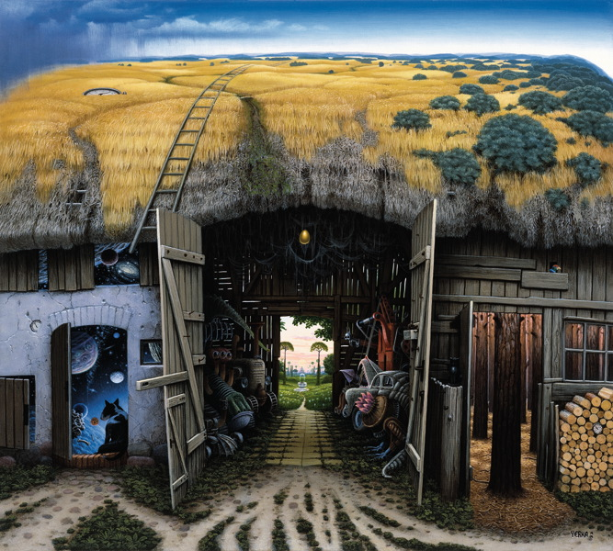
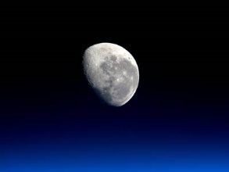
Run-Length Encoding
Relies on the presence of “runs” in the data to be encoded
Runs are sequences of exactly the same character
Instead of sending or storing AAAA, store 4A
But, when would you ever see such text in the real world?
It’s very unlikely that you would
Run-length is inefficient for text!
But, think about images…
AAAABBCDDDDEE

Slide 11
Run-Length Encoding
We iterate through the letters in the input text
Encode each run with just two characters
4A2B1C4D2E
The 1st, 2nd, 4th & 5th parts are either compressed or remain the same length
The one exception is C, where we’ve actually increased the space used
Solution to this problem
Compress only the runs that are long enough
How will we know what is compressed and what isn’t?
Use a special character (an escape character) to show compressed runs
For example, if % is the escape character, the encoding is %4A%2BC%4D%2E
But BB and EE is actually shorter than %2B and %2E
Solve this by compressing only runs that are 3 or more symbols long
For example, %4ABBC%4DEE
Consider AAABBB versus ABABAB
Huffman encoding would compress both, but could run-length encoding?
In binary there are lots of runs of 0 and 1 bits
How would you apply run-length encoding to binary data?
AAAABBCDDDDEE

